Slide 1
CS428: Software Engineering II
Specifications cont. (parameterized unit testing)

Slide 2
What is a Unit Test?
A unit test is a small program with assertions.
[TestMethod] public void Add()
{
HashSet set = new HashSet();
set.Add(3);
set.Add(14);
Assert.AreEqual(set.Count, 2);
}
Many developers write such unit tests by hand. This involves
determining a meaningful sequence of method calls,
selecting exemplary argument values (the test inputs),
stating assertions.
Notes:
What does exist today that is close? … You have seen how to pull out a value, let’s be a little bit more extreme…
Different partitions possible

Slide 3
Unit Testing: Benefits
Design and specification
by example
Code coverage and regression testing
confidence in correctness
preserving behavior
Short feedback loop
unit tests exercise little code
failures are easy to debug
Documentation

Slide 4
Unit Testing: Measuring Quality
Coverage: Are all parts of the program exercised?
statements
basic blocks
explicit/implicit branches
…
Assertions: Does the program do the right thing?
test oracle
Experience:
Just high coverage or large number of assertions is no good quality indicator.
Only both together are!

Slide 5
Advantages of tests as specs
Concrete, easy to understand
Don’t need new language
Easy to see if program meets the spec
Making tests forces you to talk to customer and learn the problem
Making tests forces you to think about design of system (classes, methods, etc.)

Slide 6
Disadvantages of tests as specs
Too specific
Hard to test that something can’t happen
Can’t withdraw more money than you have in the system
Can’t break into the system
Can’t cause a very long transaction that hangs the system
Tends to be verbose

Slide 7
Tests as specifications
Tests show how to use the system
Tests need to be readable
Need comments that describe their purpose or need good names
Keep short, delete duplicate or redundant

Slide 8
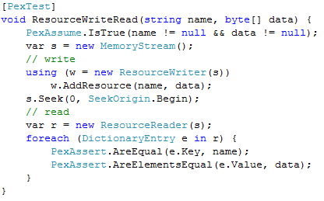
Parameterized Unit Test
A parameterized unit test is a small program that takes some inputs and states assumptions and assertions.
Parameterized Unit Test
JUnit: @Theory (multiple parameters) @Parameters (single parameter)

Slide 9
Parameterized Unit Testing
Parameterized Unit Tests
serve as specifications
can be leveraged by (automatic) test input generators
fit in development environment, evolve with the code
Parameterized Unit Test

Slide 10
PUTs separate concerns
PUTs separate two concerns:
(1) The specification of external behavior (i.e., assertions)
(2) The selection of internal test inputs (i.e., coverage)
In many cases, a test generation tool (e.g., Pex) can construct a small test suite with high coverage !

Slide 11
PUTs are algebraic specs
A PUT can be read as a universally quantified, conditional axiom.
∀ int name, int data.
name ≠ null ⋀ data ≠ null ⇒
equals(
ReadResource(name,
WriteResource(name, data)),
data)

Slide 12
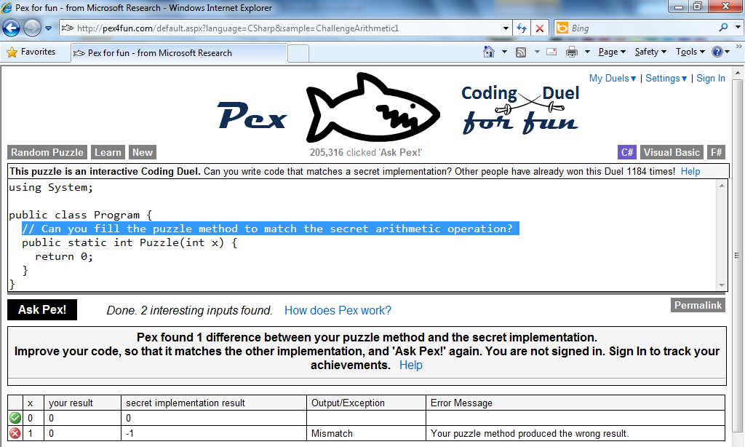
Pex4Fun – Turning Pex Online
http://pex4fun.com/default.aspx?language=CSharp&sample=_Template
1,745,654 clicked 'Ask Pex!'

Slide 13
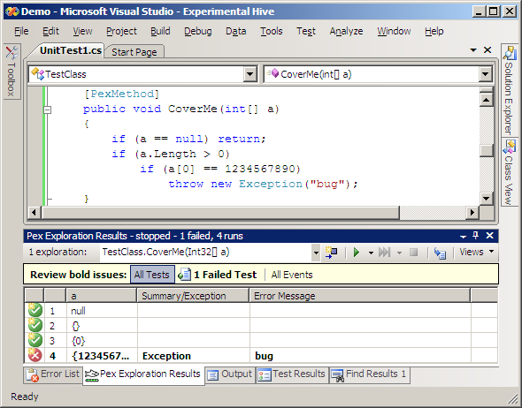
Behind the Scene of Pex4Fun
Dynamic Symbolic Execution (DSE)
aka. Concolic Testing
[Godefroid et al. 05][Sen et al. 05][Tillmann et al. 08]
Instrument code to explore feasible paths
http://research.microsoft.com/pex/

Slide 14
http://research.microsoft.com/pex/

Slide 15
Dynamic Symbolic Execution in Pex
Choose next path
Solve
Execute&Monitor
void CoverMe(int[] a)
{
if (a == null) return;
if (a.Length > 0)
if (a[0] == 1234567890)
throw new Exception("bug");
}
Constraints to solve
a!=null
a!=null &&
a.Length>0
a!=null &&
a.Length>0 &&
a[0]==123456890
Input
null
{}
{0}
{123…}
Observed constraints
a==null
a!=null &&
!(a.Length>0)
a==null &&
a.Length>0 &&
a[0]!=1234567890
a==null &&
a.Length>0 &&
a[0]==1234567890
a==null
F
T
a.Length>0
F
T
Done: There is no path left.
a[0]==123…
F
T
http://pex4fun.com/HowDoesPexWork
Notes:
15
15
15

Slide 16
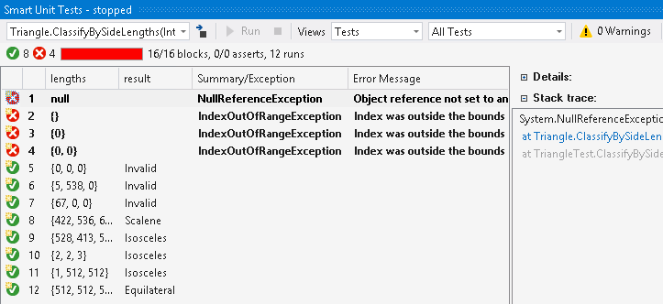
Pex is Part of Visual Studio 2015!
As new feature of “IntelliTest”
https://www.visualstudio.com/news/vs2015-vs#Testing

Slide 17
Interface for IntSet
Class IntSet {
public IntSet() {…};
public void insert(int e) { … }
public Bool member(int e) { … }
public void remove(int e) { … }
}
sort IntSet imports Int, Bool
signatures
new : -> IntSet
insert : IntSet × Int -> IntSet
member : IntSet × Int -> Bool
remove : IntSet × Int -> IntSet
http://www.cs.unc.edu/~stotts/723/adt.html

Slide 18
(Buggy) Implementation for IntSet
Class IntSet {
public IntSet() {…};
public void insert(int e) { … }
public Bool member(int e) { … }
public void remove(int e) { … }
}
See the Set.cs that can be downloaded from the course schedule web.
Let’s copy it to
http://pex4fun.com/default.aspx?language=CSharp&sample=_Template
And Click “Ask Pex”

Slide 19
Parameterized Unit Tests Supported by Pex/Pex4Fun
using System;
using Microsoft.Pex.Framework;
using Microsoft.Pex.Framework.Settings;
[PexClass]
public class Set {
[PexMethod]
public static void testMemberAfterInsertNotEqual(Set s, int i, int j) {
PexAssume.IsTrue(s != null);
PexAssume.IsTrue(i != j);
bool existOld = s.member(i);
s.insert(j);
bool exist = s.member(i);
PexAssert.IsTrue(existOld == exist);
}
….
}
Pex4Fun supports only one PexMethod at a time;
you can write multiple PexMethods but comment out other lines of “[PexMethod]” except one

Slide 20
Axioms for IntSet
variables i, j : Int; s : IntSet
Axioms:
member(new(), i) = false
member(insert(s, j), i) =
if i = j then true
else member(s, i)
Is this complete?
How do we know?
http://www.cs.unc.edu/~stotts/723/adt.html

Slide 21
Guidelines for Completeness
Classify methods:
constructors: return IntSet
inspectors: take IntSet as argument, returning some other value.
Identify key constructors, capable of constructing all possible object states
e.g., insert, new.
Identify others as auxiliary,
e.g., remove is a destructive constructor
Completeness requires (at least):
every inspector/auxiliary constructor is defined by one equation for each key constructor.

Slide 22
Add More Axioms
remove(new(), i) = new()
remove(insert(s, j), i) = if i = j then remove(s, i) else insert(remove(s, i), j)
Are we done yet?
The completeness criterion (an equation defining member and remove for each of the new and insert constructors) is satisfied.

Slide 23
Guidelines for Completeness
But does this really specify sets? Do the following properties hold?
Order of insertion is irrelevant.
insert(insert(s, i), j) = insert(insert(s, j), i)
Multiple insertion is irrelevant.
insert(insert(s, i), i) = insert(s, i)

Slide 24
Interface (Implementation) for UIntStack
Class UIntStack {
public UIntStack() {…};
public void Push(int k) { … }
public void Pop() { … }
public int Top() { … }
public bool IsEmpty() { … }
public int MaxSize() { … }
public bool IsMember(int k) { … }
public bool Equals(UIntStack s) { … }
public int GetNumberOfElements() { … }
public bool IsFull() { … }
}
See the UIntStack.cs that can be downloaded from the course schedule web.

Slide 25
Group Exercise: Write Parameterized Unit Tests (PUTs)
Let’s copy it to
http://pex4fun.com/default.aspx?language=CSharp&sample=_Template
And Click “Ask Pex”
Class UIntStack {
public UIntStack() {…};
public void Push(int k) { … }
public void Pop() { … }
public int Top() { … }
public bool IsEmpty() { … }
public int MaxSize() { … }
public bool IsMember(int k) { … }
public bool Equals(UIntStack s) { … }
public int GetNumberOfElements() { … }
public bool IsFull() { … }
}
Reminder: you have to comment earlier written “[PexMethod]” before you try Pex on your current PUT (Pex4Fun can handle only one PUT at a time)
See the UIntStack.cs that can be downloaded from the course schedule web.

Slide 26
(Buggy) Implementation for IntSet
Class IntSet {
public IntSet() {…};
public void insert(int e) { … }
public Bool member(int e) { … }
public void remove(int e) { … }
}
See the Set.cs that can be downloaded from the course schedule web.
Let’s copy it to
http://pex4fun.com/default.aspx?language=CSharp&sample=_Template
And Click “Ask Pex”

Slide 27
Parameterized Unit Tests Supported by Pex/Pex4Fun
using System;
using Microsoft.Pex.Framework;
using Microsoft.Pex.Framework.Settings;
[PexClass]
public class Set {
[PexMethod]
public static void testMemberAfterInsertNotEqual(Set s, int i, int j) {
PexAssume.IsTrue(s != null);
PexAssume.IsTrue(i != j);
bool existOld = s.member(i);
s.insert(j);
bool exist = s.member(i);
PexAssert.IsTrue(existOld == exist);
}
….
}

Slide 28
Coding Duels
1,745,654 clicked 'Ask Pex!'

Slide 29
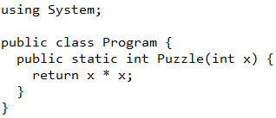
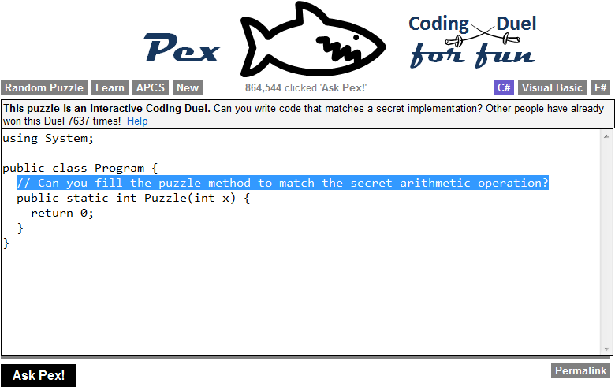
Coding Duels
Pex computes “semantic diff” in cloud
secret reference implementation vs.
code written in browser
You win when Pex finds no differences
secret
For more info, see our ICSE 2013 SEE paper: http://taoxie.cs.illinois.edu/publications/icse13see-pex4fun.pdf

Slide 30



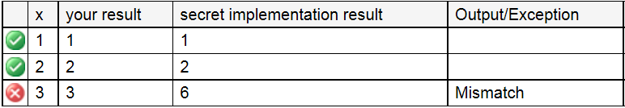
Behind the Scene of Pex for Fun
behavior
Secret Impl == Player Impl
Player Implementation
Secret Implementation
class Player {
public static int Puzzle(int x) {
return x;
}
}
class Secret {
public static int Puzzle(int x) {
if (x <= 0) return 1;
return x * Puzzle(x-1);
}
}
1,594,092
1,594,092
class Test {
public static void Driver(int x) {
if (Secret.Puzzle(x) != Player.Puzzle(x))
throw new Exception(“Mismatch”);
}
}

Slide 31
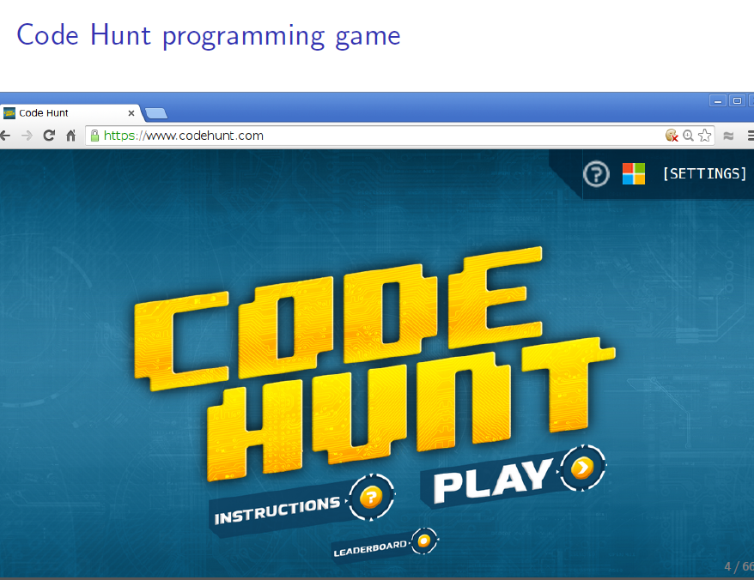
Code Hunt Programming Game
https://www.codehunt.com/

Slide 32
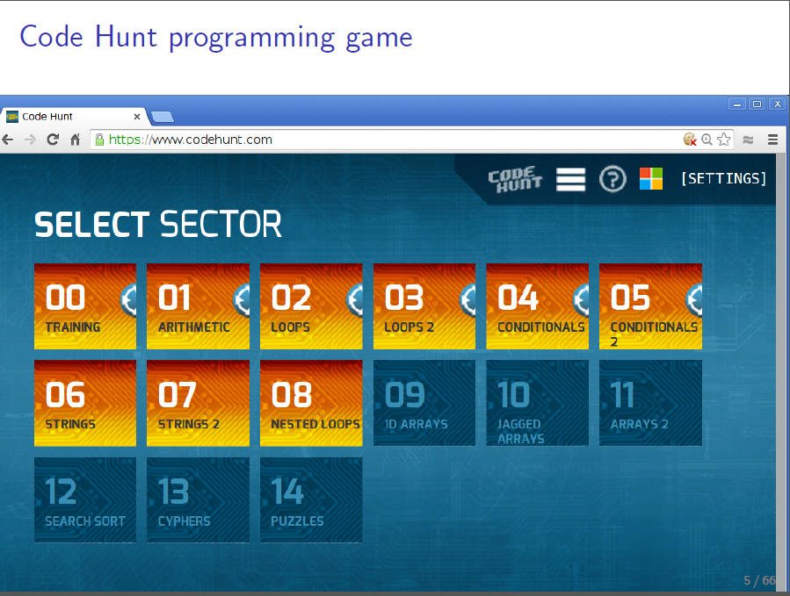
Code Hunt Programming Game

Slide 33
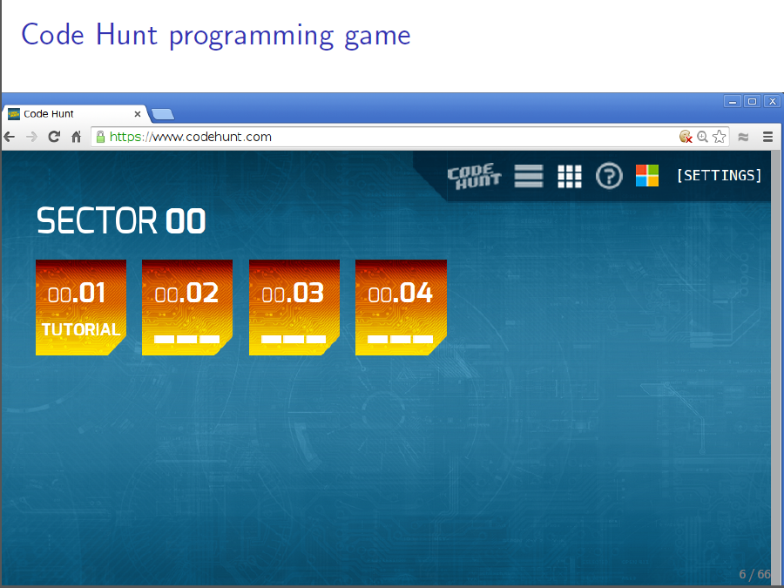
Code Hunt Programming Game

Slide 34
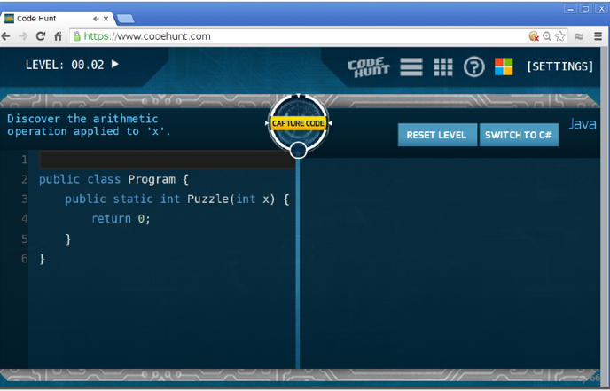
Code Hunt Programming Game

Slide 35
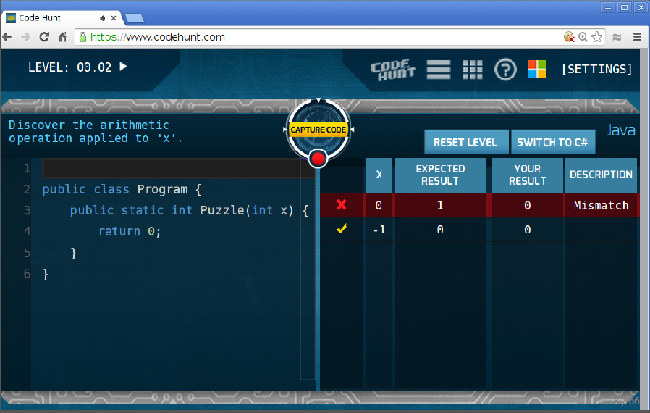
Code Hunt Programming Game

Slide 36
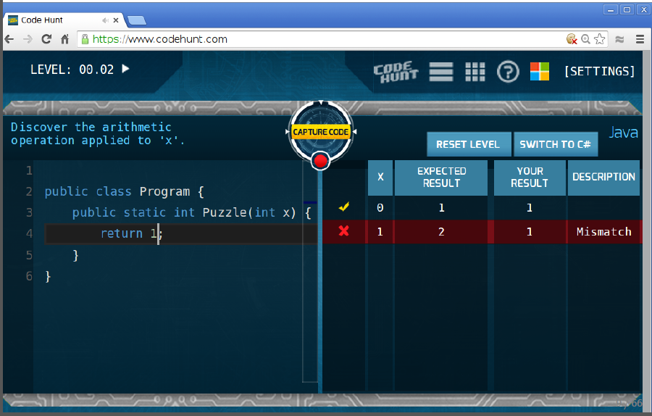
Code Hunt Programming Game

Slide 37
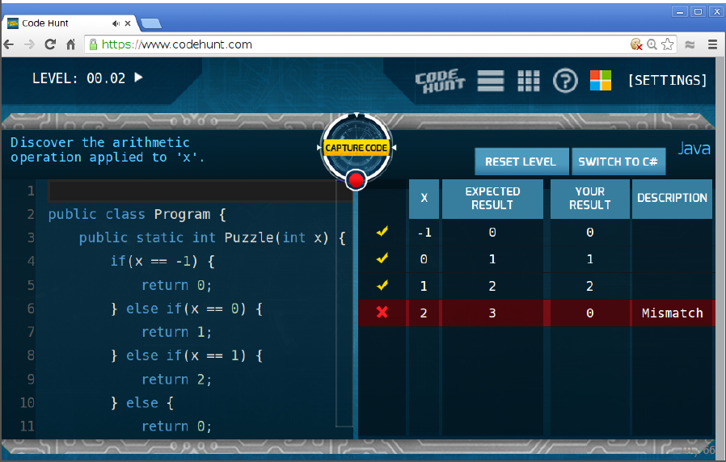
Code Hunt Programming Game

Slide 38
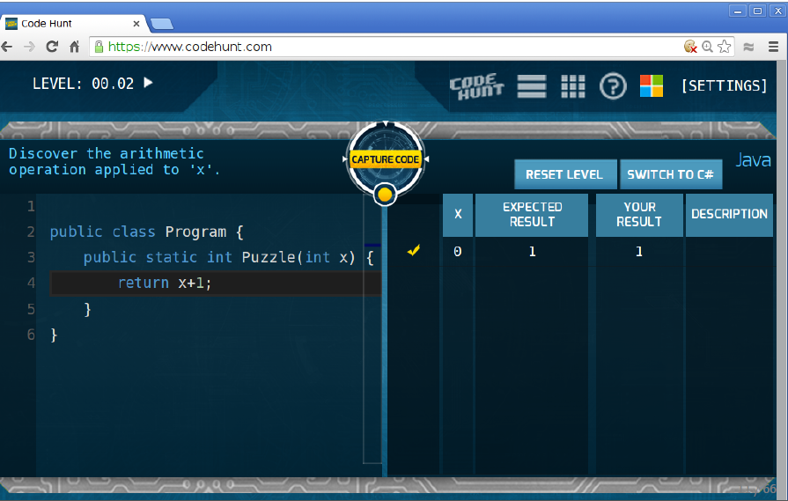
Code Hunt Programming Game

Slide 39
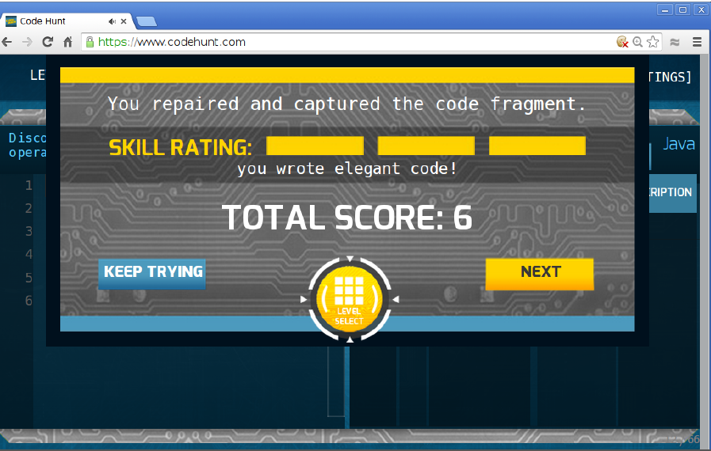
Code Hunt Programming Game

Slide 40
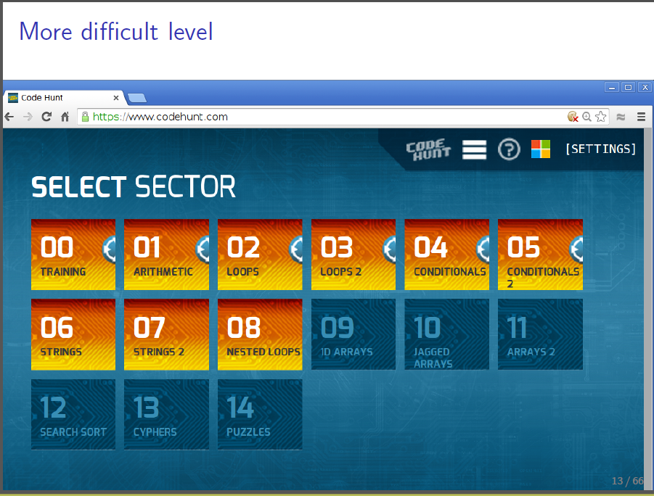
Code Hunt Programming Game

Slide 41
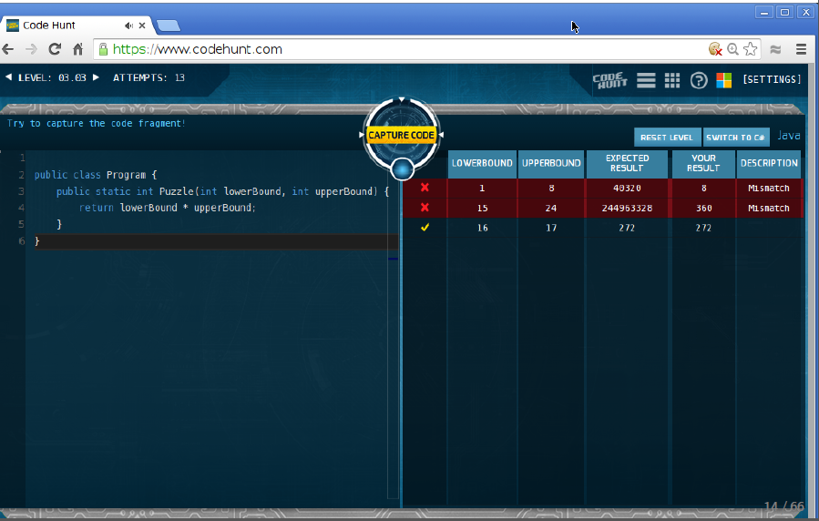
Code Hunt Programming Game

Slide 42
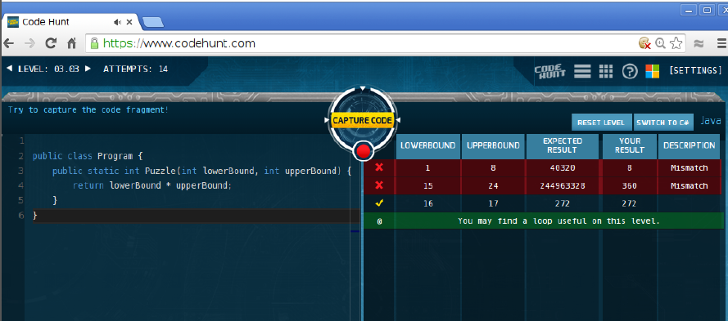
Code Hunt Programming Game

Slide 43
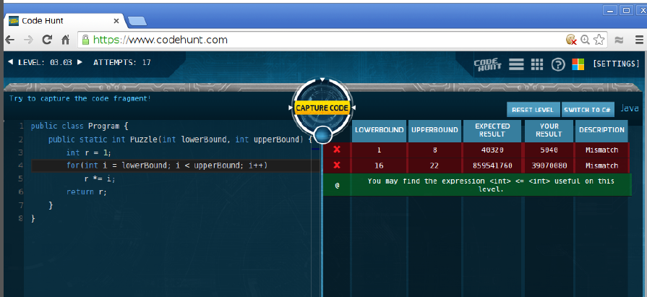
Code Hunt Programming Game

Slide 44
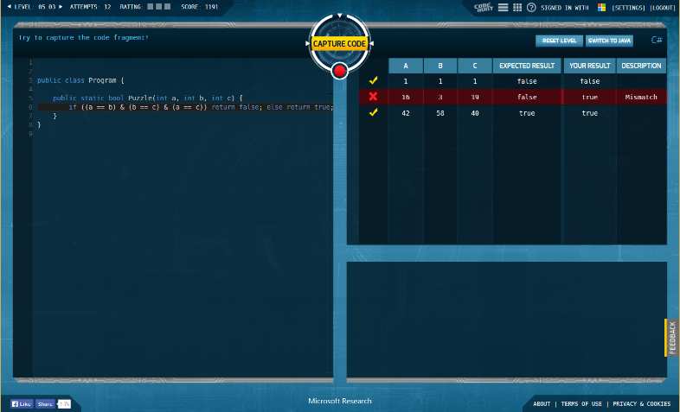

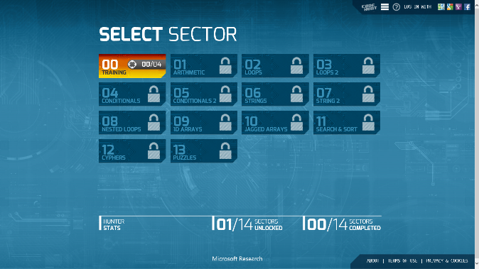
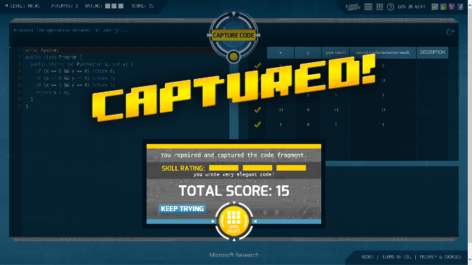
It’s a game!
code
iterative gameplay
adaptive
personalized
no cheating
clear winning criterion
secret
test cases

